Slide 1
Seattle Crime Analysis - 2024 Overview
Team 4
Yousef
Shraddha
Alysia
Trevor

Slide 2



Dataset Description
Dataset Size & Scope
Key Data Fields
Business Use Case
81,771 crime reports from Seattle Police Department, 2024
Includes date/time, location, crime type, precinct, and neighborhood
Useful for resource allocation, hotspot mapping & crime prevention

Slide 3



Data Preparation
Loading the Data
Cleaning & Formatting
Handled Missing & Redacted values
Original dataset contained over 1.47 million rows; had to filter for 2024 data
Made report dates and offense date consistent
Cleaned incomplete records for consistent analysis

Slide 4
Analysis Objectives
1
2
3
Identify most frequent types of crime
Identify areas with highest levels of crime
Help plan where to send police and resources

Slide 5
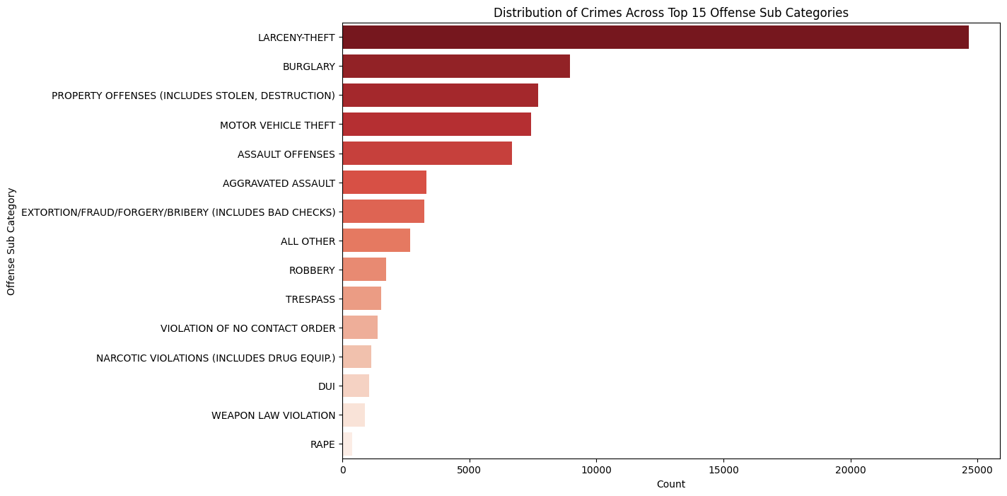
Crimes by Category

Slide 6
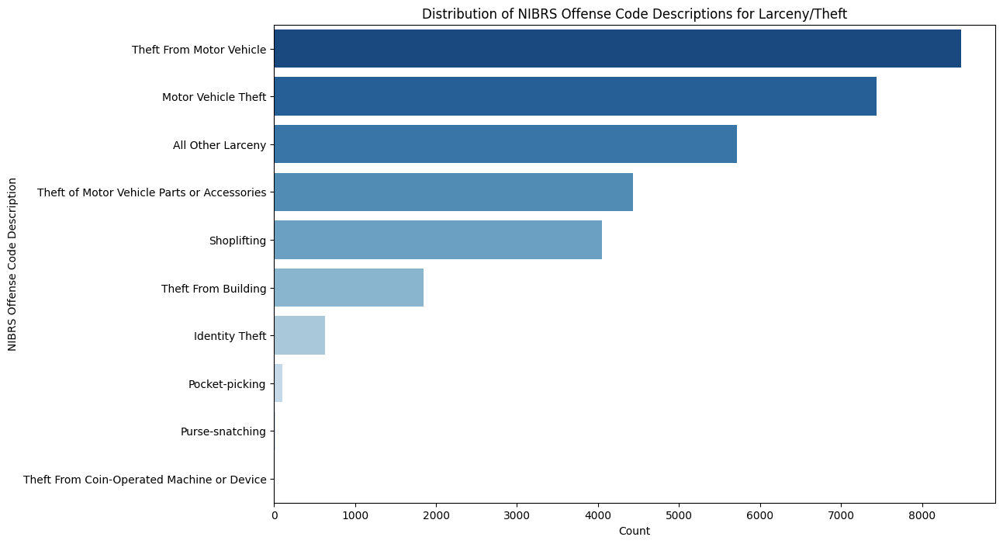
Breakdown of Larceny/Theft Crimes

Slide 7
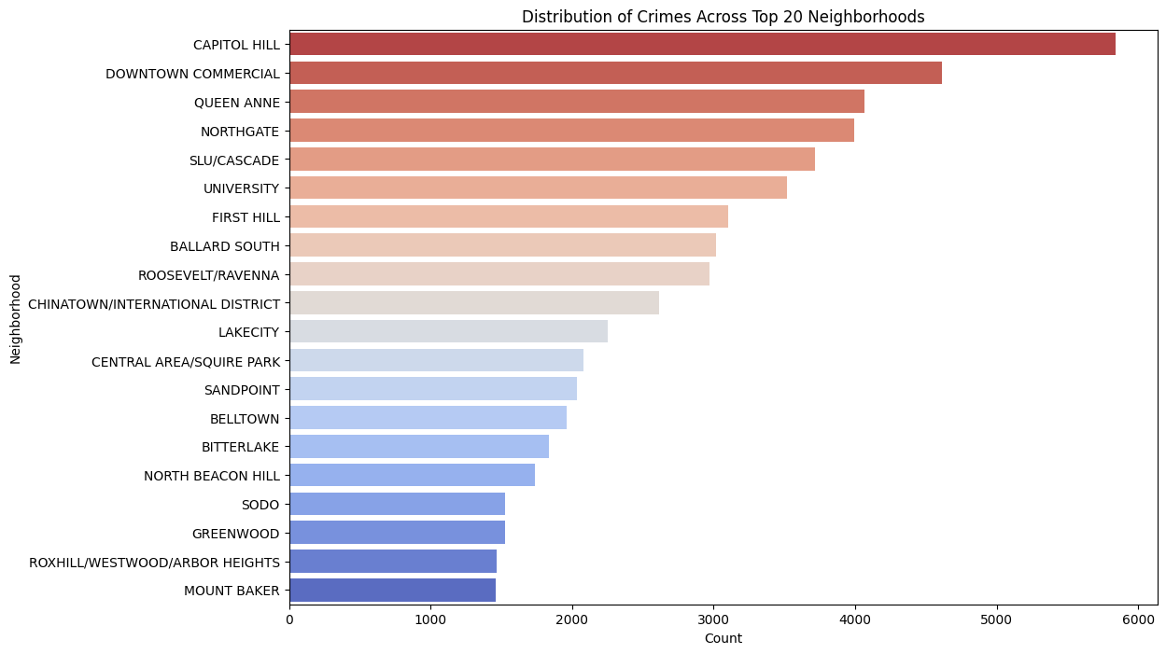
Distribution of Crimes by Neighborhood

Slide 8
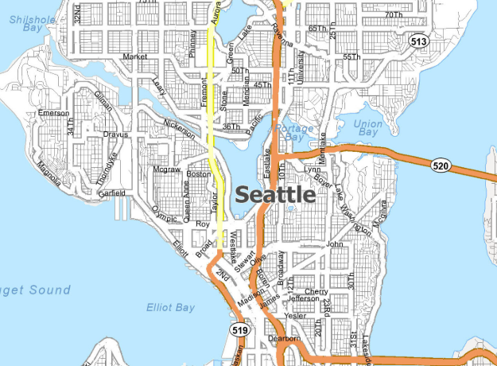
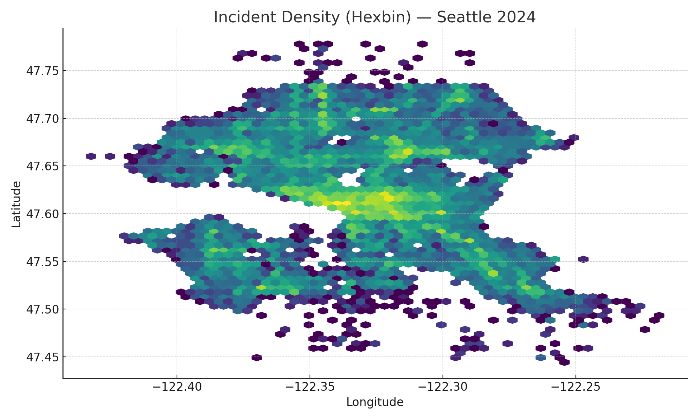
Analysis by Hotspots
Top Neighborhoods:
CAPITOL HILL
DOWNTOWN COMMERCIAL
QUEEN ANNE
NORTHGATE
SLU/CASCADE
Top Precincts:
North
West
East
South
Southwest

Slide 9
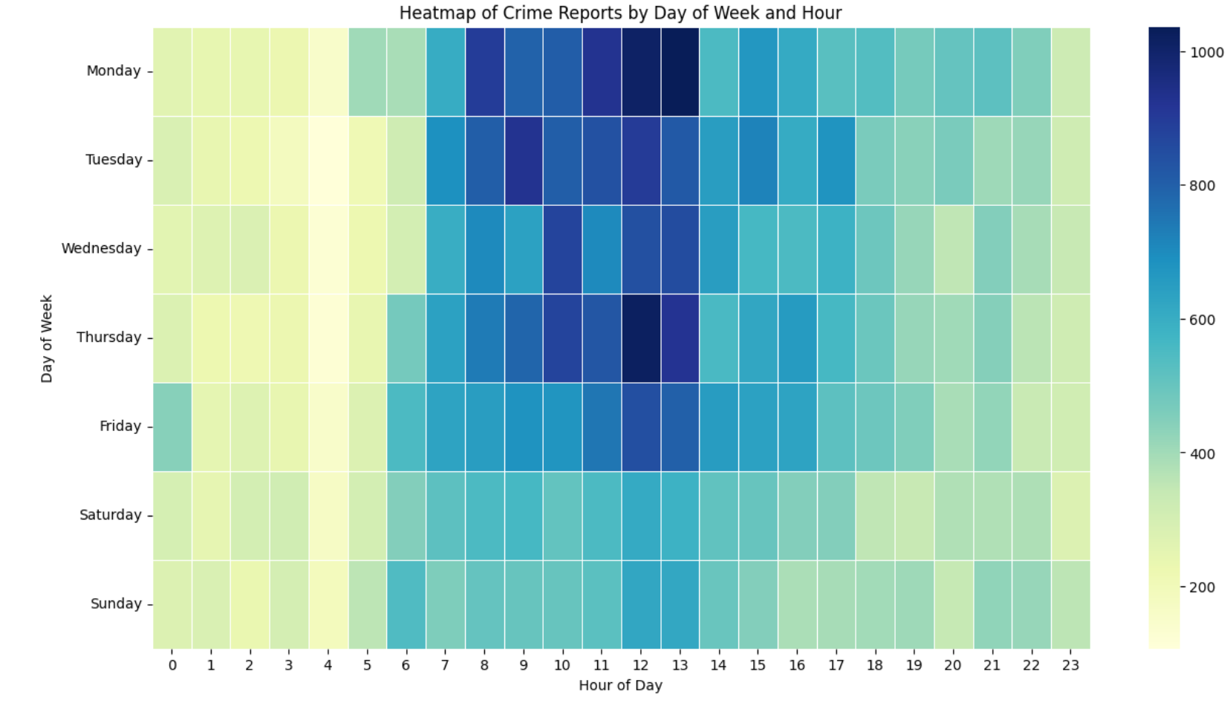
Predictive Modeling

Slide 10
Linear Regression Model
Linear Regression Model – Crime Count Prediction based on areas and categories as features
Objective: Predict number of crimes in an area using historical crime data and relevant features.
Selected Features: 'Neighborhood', 'Sector', 'Beat', 'Offense Sub Category', 'NIBRS Crime Against Category', 'Offense Category', 'NIBRS Offense Code Description' , 'NIBRS Group AB'

Slide 11
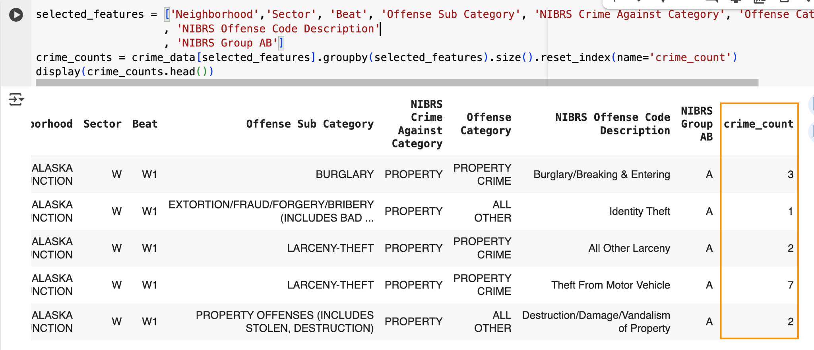
Linear Regression Model
Data Preparation:
- Aggregated crime data by relevant features (area & time).

Slide 12
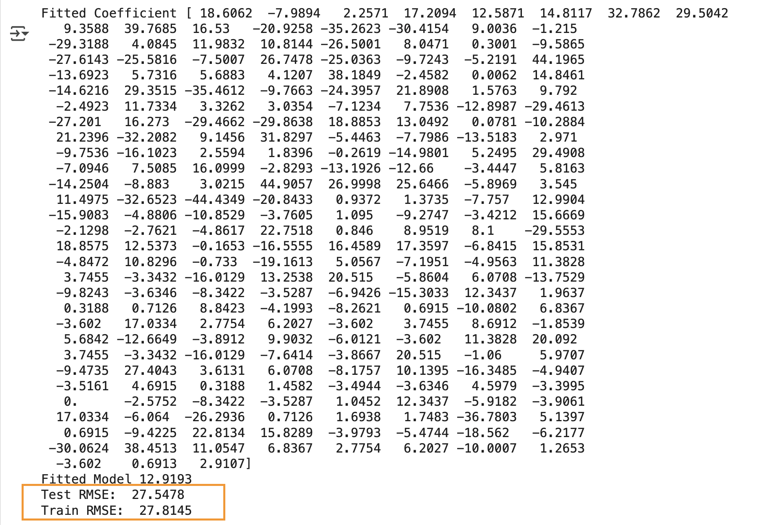
Linear Regression Model
Converted categorical variables to numerical format (0,1) via one-hot encoding.
Split data into training and testing sets. (80% train and 20% test), divided data randomly at the value 42
Model Development
Trained a Linear Regression model on training data.
Predicted value for the test data.
Evaluated model performance using Root Mean Squared Error (MSE)
Train RMSE
Test RMSE
(RMSE is difference between the actual and predicted values)
Lower value implicates the model is able to find fair patterns between features.
The value can be further improved by increasing data set size.

Slide 13
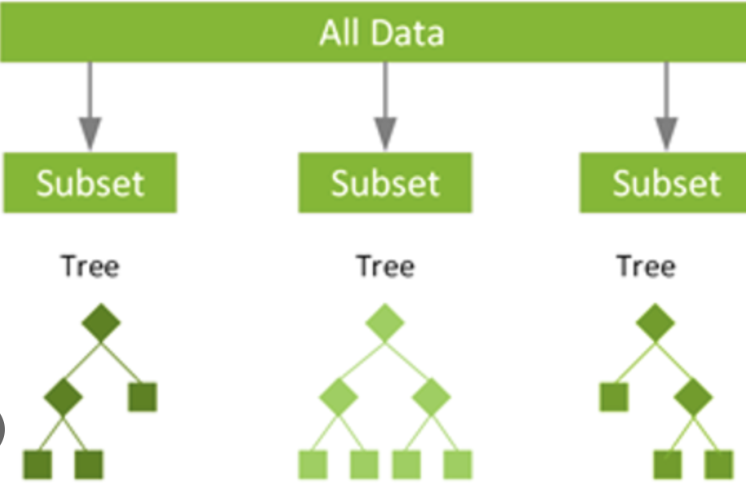
Random forest Classification Model
Tried prediction based of a classification model i.e. Random forest (multi variable classification) classifier
Tried to predict ‘Offense Subcategories’ based on 'Neighborhood', 'Precinct', 'Sector', 'Beat', 'Report Hour', 'Report Day of Week', 'Offense Hour', 'Offense Day of Week'

Slide 14
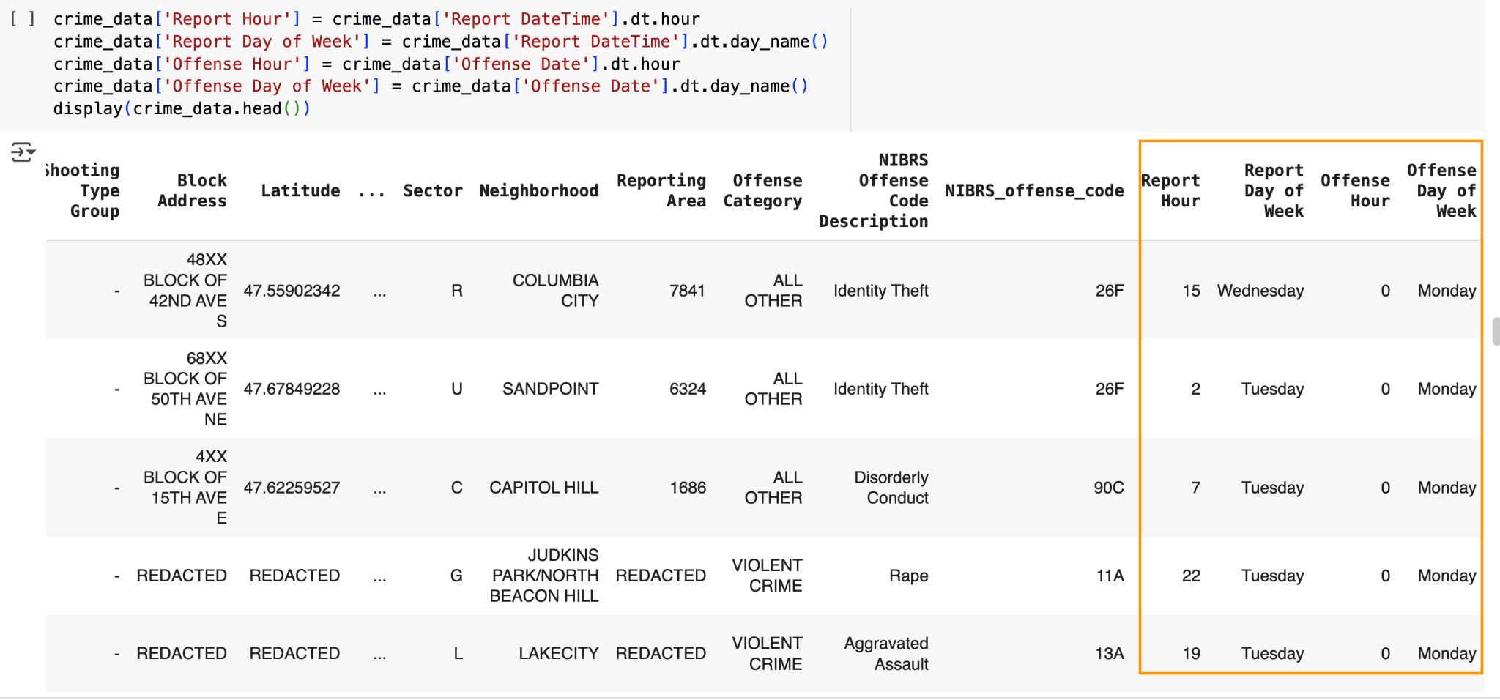
Random forest Classification Model
Extracted data for Report Hour', 'Report Day of Week', 'Offense Hour', 'Offense Day of Week'

Slide 15
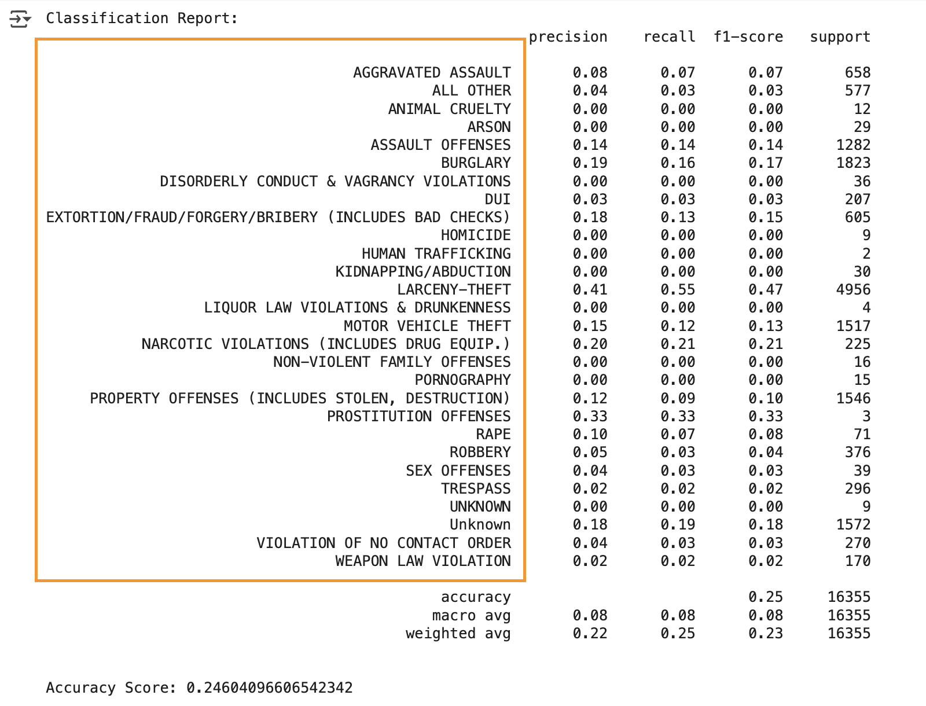
Random forest Classification Model
The trained model achieved an accuracy of approximately 0.246 on the test set.
We got fairly lower accuracy on this model,
Various types of ‘Offense sub category’ and the data for the model to be trained was relatively less.
The model was not able to establish correlation between the features.
We could improve the accuracy by improving the model’s ability to detect patterns by providing it data which spans over a larger period of time.

Slide 16
Random forest Classification Model
We tried to predict ‘Precinct’ based on 'Neighborhood', 'Sector', 'Beat', 'Report Hour', 'Report Day of Week', 'Offense Hour', 'Offense Day of Week'
The model achieved an accuracy of 1.0 (100% accuracy)
Overfitting on the test data - model is not learning patterns).
Might not work well on new data set
We tried to predict ‘Offense Category' based on same features as precinct
The model achieved an accuracy of approximately 61.27% when predicting 'Offense Category'.
The significant difference in accuracy across the target variables suggests that the current features (location, time, day) are much stronger predictors of ‘Precinct’ than of the ‘Offense Category'.
To improve the prediction accuracy for 'Offense Category' we might have to incorporate additional features that might be more directly related to crime types, such as other factors, historical crime data patterns, or environmental factors.

Slide 17

How would the data help them to make better decisions?
Understanding crime patterns
Understanding reporting behaviour
Understand which neighborhoods need more security, and allocate resources accordingly
Awareness on exactly what type of crimes occur in Seattle
Understand how to keep the city more safe and secure
Notes:
They can adjust their budget, in terms of police needed, installing more security cameras, building safer infrastructure
Geographic analysis reveals crime patterns
Ways to improve public safety,
Partner with community organizations or drug code enforcement officers to ensure urban planners includes crime prevention

Slide 18

Who will benefit from this?
Population
Police
Urban planners
City
Businesses
Tourism
Community
Economic growth
Notes:
Police departments benefit from increased community trust, improved crime prevention, and greater resource allocation
Know what to look out for, how to prevent certain types of crime, where to allocate resources, who will benefit from it
Everyone and everything benefits from a safer city. Residents experience an enhanced quality of life and have a greater peace of mind.
Safe neighborhoods foster a greater sense of community, and social interaction and participation in local activities is increased.
Mental and physical health benefits due to reduced fear of crime and a higher sense of security.
Businesses will thrive as well from this, leading to economic growth.
The city will have a greater reputation, which leads to more tourism as well. All in all, a safer city will lead to only positive changes.

Slide 19
Recommendations
More secure parking lots (security guards, secure gates)
More police monitoring in areas with higher crime
More security cameras
Public awareness and security training (lock doors and windows, use a steering wheel lock, audible alarms, remove valuables, park in well-lit areas)
Ensure people are informed of alerts of crime in the area
Improve police community relations
Explain graphs, show the data and list of crimes to management
Notes:
We can remove any challenges residents may face with reporting crime, perhaps implementing automation.
Quality and well-curated data is crucial to improve, This ensures public safety solutions are designed to meet specific community needs.

Slide 20
Challenges
Offense time only includes date, not time
Some crimes had a long report time
Data on time it takes for police to arrive at crime scene
Very large data set, had to filter dataset to only 2024
Google Colab has limited RAM
Notes:
2008-2024
We ran into issues with google colab crashing because we had limited ram

Slide 21
Future Improvements
How we would do the project differently?
Analyze different years
Combine more data sets
Precinct heat maps for individual districts

Slide 22
How AI tools assisted in the project
Fact check data
Generate more quantifiable properties
Provide additional perspective during data interpretation
Provide ideas on what visuals would represent the dataset

Slide 23
Q&A!

